Slide 1
Image Processing
Unit 4
Video 4.1
Morphological Image Processing

Slide 2
Agenda
What is Morphology?

Slide 3
Agenda
What is Morphology?
Morphology in Image processing

Slide 4
Agenda
What is Morphology?
Morphology in Image processing
Morphological Operations

Slide 5
What is Morphology?
Morphology in Biology :
Study of form and structure of animals and plants

Slide 6
What is Morphology?
Morphology in Biology :
Study of form and structure of animals and plants
Morphology in Linguistics :
Study of words, their structure and relationship with other words

Slide 7
Morphology in Image processing
Technique to analyze and process the geometrical shapes in an image

Slide 8
Morphology in Image processing
Technique to analyze and process the geometrical shapes in an image
For Image Enhancement

Slide 9
Morphology in Image processing
Technique to analyze and process the geometrical shapes in an image
For Image Enhancement
Applicable on Binary Images and Gray Scale images

Slide 10

Morphology in Image processing
Background vs Foreground
Black region : background
White region : Foreground

Slide 11
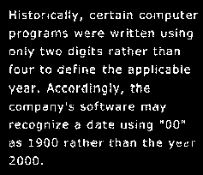

Morphological Operations
Use case 1:
Source image

Slide 12
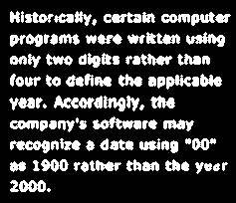

Morphological Operations
Use case 1:
Source image
Processed image

Slide 13
Morphological Operations
Use case 1:
This Operation is Called Dilation
Source image
Processed image

Slide 14
Morphological Operations (Dilation)
“Grows” or “thicken” an object in binary image

Slide 15
Morphological Operations (Dilation)
“Grows” or “thicken” an object in binary image
How an Object will grow?
By using Structuring Element

Slide 16
Morphological Operations (Dilation)
“Grows” or “thicken” an object in binary image
How an Object will grow?
By using Structuring Element
How much an Object will grow?
Depends on Shape of Structuring Element

Slide 17
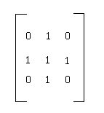
Morphological Operations
What is Structuring Element?
M x N Matrix of Ones and Zeros
Also known as kernel

Slide 18
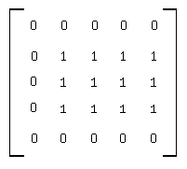
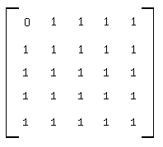
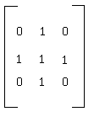
Morphological Operations (Dilation)
SE crawls over entire image pixel by pixel
Structuring element
Source image
Processed image

Slide 19
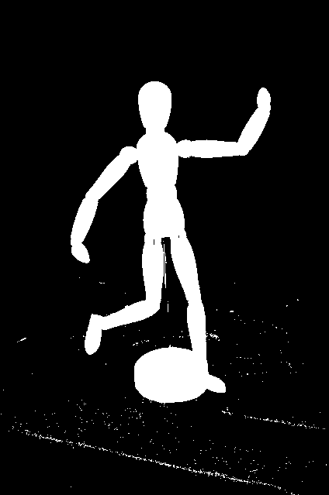

Morphology Operations
Use case 2:
Source image
Processed image

Slide 20
Morphology Operations
Use case 2:
This operation is called Erosion
Source image
Processed image

Slide 21
Morphological Operations (Erosion)
“Shrink” or “thin” an object in binary image
Structuring element shrinks object

Slide 22
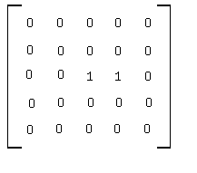
Morphological Operations (Erosion)
SE crawls over entire image pixel by pixel
Structuring element
Source image
Processed image

Slide 23
Morphological Operations (Opening)
Erosion followed by Dilation
Source image
Processed image

Slide 24
Morphological Operations (Opening)
Erosion followed by Dilation
Mathematical Expression :
F : input image
S : structuring element
F S=(F S) S

Slide 25

Morphological Operations (Closing)
Dilation followed by Erosion
Source image
Processed image

Slide 26
Morphological Operations (Closing)
Dilation followed by Erosion
Mathematical Expression :
F : input image
S : structuring element
F S=(F S) S

Slide 27
Summary
Morphology
Structuring Element
Dilation
Erosion
Opening
Closing

Slide 28
Thank you

